Slide 1
The Devil You Know: Threat Construction in the United States
Data source:
Internet Archive’s .Gov Collection
E-Science Data Incubator Participant:
Emily Kalah Gade
Project Leads:
Dr. John Wilkerson
Dr. Magdalena BalAzINSKA

Slide 2
Project Background: Scope
Political Science Side - NSF Grant re: Poli-Infomatics
Explore the wealth of textual resources available today
Measuring ideas in text… Using computers to do it
Computer Science Side – Text in Myria

Slide 3
Project Background: Data Source
Internet Archive .gov collection
90 terabytes of data, 1.1 billion captures
Hosted by Altiscale on a Hadoop Cluster
Incubator project:
Figure out what is “in there”
Make it useful for social science research
Focus: Language about threats – terrorism, climate change, and banking crisis

Slide 4
Incubator Goals
Access the cluster, run scripts, get output
Reliability and validity
Results and write up
Make it reproducible and accessible to other social scientists

Slide 5
Initial Hurdles
Emily’s coding abilities
General big data issues
Nit picky issues: unicode, parsers, carriage returns
Best format for examining data
Reliability and validity
Reproducibility for anyone else (without the incubator!)

Slide 6
What a capture looks like once parsed

Slide 7
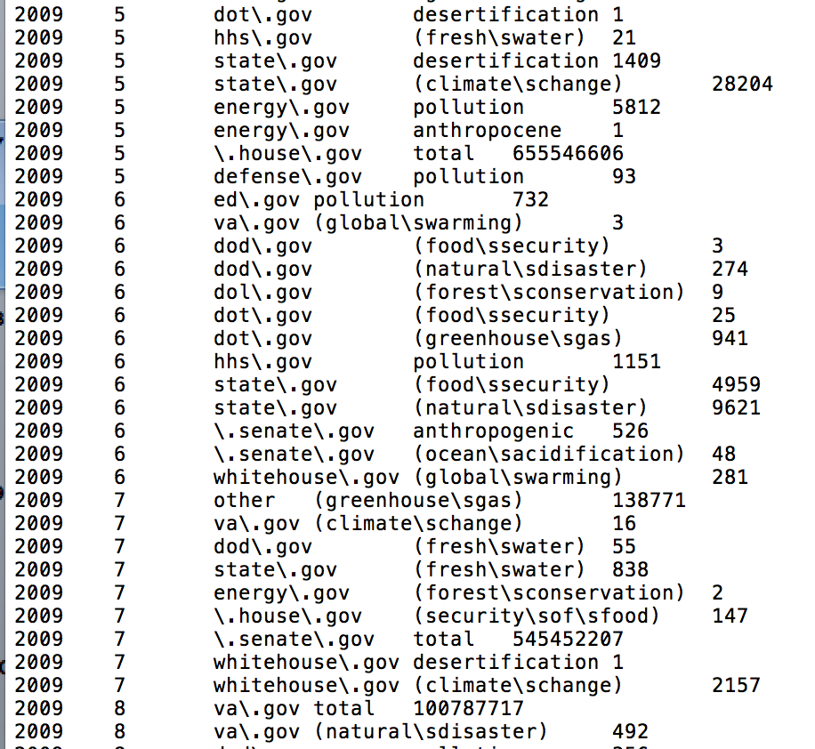
What word count data looks like

Slide 8
Data Quality
Complete Crawls Taken from Nov to Jan around elections from 2004 to present
This becomes Gold Standard
Early data crawled irregularly
Early data sensitive to terms

Slide 9
Preliminary Results
Correspondence Analysis
Angles between topics and agency indicate more emphasis of that topic by that agency (smaller angels = more emphasis)
Interagency distances and inter topic distances are interpretable (but not topic-agency distances)

Slide 10
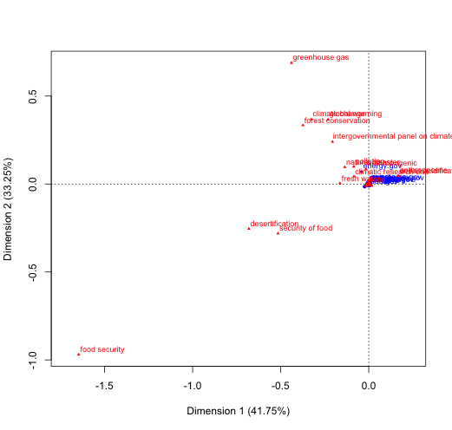
2004 Agency Relative Emphasis Biplot

Slide 11
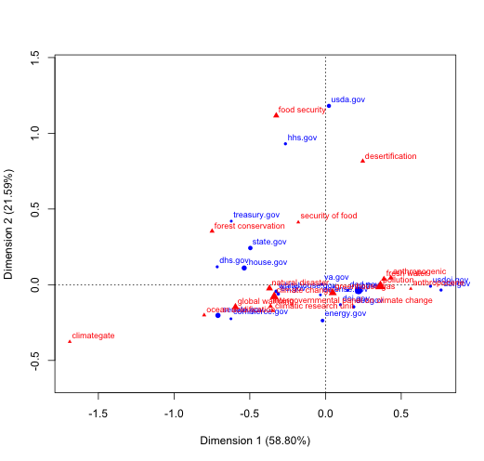
2008 Agency Relative Emphasis Biplot

Slide 12
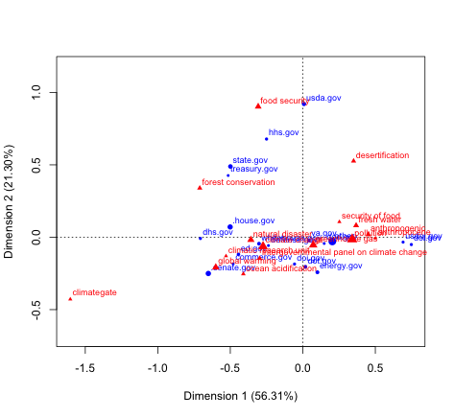
2012 Agency Relative Emphasis Biplot

Slide 13
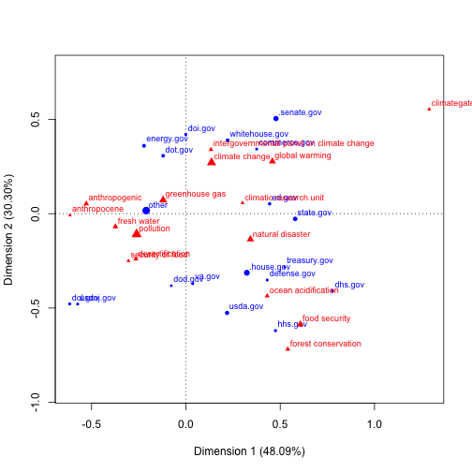
2013 Agency Relative Emphasis Biplot

Slide 14
Creating Institutional Memory
Taking data to PoliInfomatics conference
Publishing code on Github, publishing data on PoliInfomatics
Contact with Internet Archive and two other groups known to be exploring this data
One at Harvard, one in Germany
Article re: .gov collection as a data source

Slide 15
Proposed Publications
Methodological Paper re: .gov data as a data source for social science research
Including preliminary results and scripts
The Devil You Know: Threat Construction in the United States
Tracking threat construction in the US; Agenda analysis

Slide 16
Thank You!

